Slide 1
Support for University Applications Transition to A2 Parents' Event (June 2024)
Debbie Macintosh – Senior Tutor Manager
Lindsey Dhokia – Careers Adviser

Slide 2
Universities & Degrees
Making the right choices

Slide 3
Choosing the right degree
Undergraduate Bachelor’s degree: 3 or 4 years full time.
Foundation Year: Extra year at the beginning of a Bachelor’s degree.
Vocational degree?
New subject or old?
Variation on a theme...
Single or Joint/Combined
What do graduates do?

Slide 4
Choosing the right degree
What does the course cover?
Courses with the same title may be very different.
Look carefully at the core course content, and the range of optional studies/modules available.
Which modules are the most interesting and relevant to your career aspirations?
Internship, placement, sandwich or study abroad opportunities.
How is the course taught – structured teaching, or more independent research? How many lectures are there, and how much group work will be done in seminars?
How is the course assessed?
Entry requirement?
Notes:
Over 35,000 courses

Slide 5
Choosing the right university
Style - traditional research intensive; modern with a greater focus on vocational courses; specialist
Location - home or away? large city, small town, by the coast, in the countryside, campus?
Size - larger universities can have more than 20,000 students, whereas some of the smallest have only a few thousand.
Culture and facilities - influenced by a range of factors, including the diversity of students who attend.
What graduates do - find out what career, jobs or further study students go on to.
Costs – university scholarships & bursaries,accommodation, transport, and food can vary enormously.
UCAS search tool https://digital.ucas.com/search
University League Tables https://ultimateguides.ucas.com/usingtheleaguetable/

Slide 6
What is UCAS?
UCAS is an independent charity providing information, advice and admissions services.
UCAS does:
UCAS doesn’t:
provide information, advice, and support
process applications
complete fraud and verification checks
make decisions or offers
set entry requirements
advise on finance

Slide 7
UCAS Keeping parents informed
www.ucas.com/parents
Sign up for the UCAS parents newsletter
https://www.ucas.com/parents-signup
UCAS guides
https://ultimateguides.ucas.com/

Slide 8
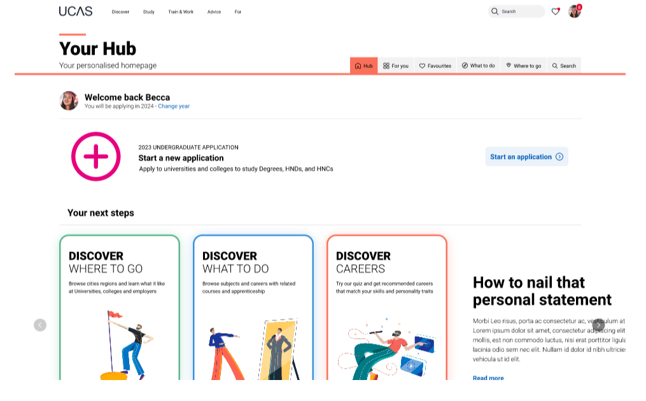
The UCAS Hub
Students are registered with the UCAS Hub to:
explore careers, degrees, universities and apprenticeships
search university open days, events and virtual tours
turn predicted grades into UCAS Tariff points
speak to university students using Unibuddy
Try before you apply with Subject Spotlights from Springpod
take the UCAS Quiz to find your career matches
start your application

Slide 9
Student registers for a UCAS Hub account to carry out research and start application.
Student completes all sections of the application and sends it to their school/college.
Teacher or adviser reviews the application and adds reference and predicted grades.
Applications are sent to UCAS by college on behalf of the student.
Universities make their decisions on the application.
The UCAS Application Process
Students can apply for up to five choices​
Applying costs £28.50.

Slide 10
Activities within the A1 tutorial curriculum to support university applications…
A1 tutorial curriculum | How students and parents can help
Introduction and registration with Unifrog (Jan 2024) | Familiarise yourself with the various tools and functions of the Unifrog platform
Introduction to simple careers searches, i.e. the UCAS Career Quiz/ Unifrog Profile Quizzes to assist those students who are as yet, unsure about their career intentions (Jan- Feb 2024) | Complete tests and research potential careers/job role suggestions as a result of the simple careers searches
Independent Unifrog research task set to all students to create short lists for both university courses and apprenticeships (Jan 2024) | Revisit the shortlists and familiarise yourself with key information (for example, entry requirements, salaries, student satisfaction, modules)
UCAS Discovery/HE Exhibition in Manchester (March 2024) | To attend and conduct face to face research during further university events
Signposted online events to all A1 students (for example, National Apprenticeship Week (w/b 5 Feb), National Careers Week (w/b 4 March) | To attend relevant online events and engage with online talks and workshops, etc.
Student Life/Finance Talks delivered by a variety of universities (March 2024) | Students to discuss key information with parents/guardians

Slide 11
More recently and still to come…
A1 Tutorial curriculum | How students and parents can help
Introduction to writing Personal Statements (March 2024) and Excelling your personal statement with extra-curricular activities (May 2024) | Students were asked to complete 1st draft using resources provided/UCAS Hub by 7th June and upload to Cedar. Studenst should continue to work on and refine their Personal Statement throughout the summer.
Researching options utilising the UCAS Hub and understanding entry requirements and contextual offers (May 2024). | Students to explore potential university course choices/ key information and discuss with parents/guardians
Spotlight on Making the Most of Open Days and communication of university open days and careers events (May 2023) | Students and/or parents/guardians to attend university open days and/or careers events
Registration for and completion of the online UCAS application – Profile section (June 2024) | Students to complete UCAS application
1 to 1 meetings with Senior Tutors and/or Careers to discuss future career plans after college (May/June 2024) | Students to prepare for the meetings with ideas they may wish to discuss and book Careers appointments for guidance (where appropriate)
Email Careers Team on careers@asfc.ac.uk

Slide 12
Preparation in A1 for A2
Registered/completed UCAS application (not including Choices)
Record of skills, work experience, activities, etc. in your ILP (Cedar)
An apprenticeship shortlist and/or a UK universities shortlist using Unifrog
Attendance to Open Days and/or Careers Events
A draft personal reflective statement (using recommended UCAS proforma) of at least 3000 characters, uploaded to your ILP (Personal Statement section) Cedar.
Reviewed by Senior Tutor via tutorial as part of
Progression Month (June)

Slide 13
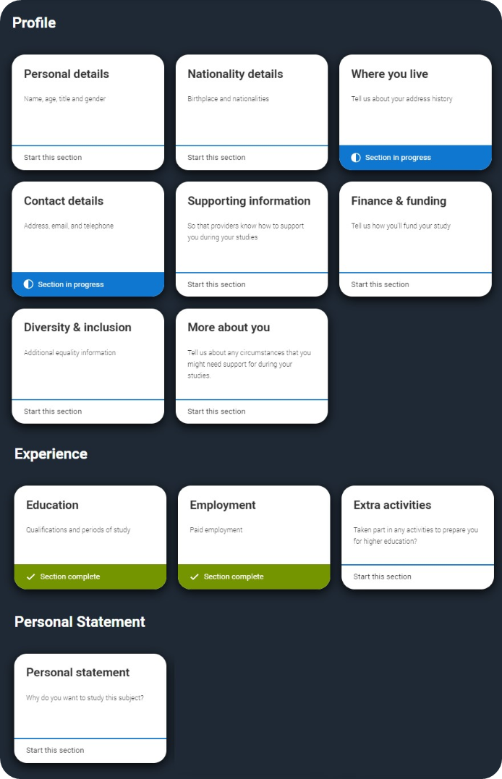
What does the UCAS Application look like?
Profile:
Personal details
Nationality details
Where you live
Contact details
Supporting information
Finance & funding
Diversity & inclusion
More about you
Experiences:
Education
Employment
Extra activities
Personal statement
Add Choices (up to 5)
Reference

Slide 14
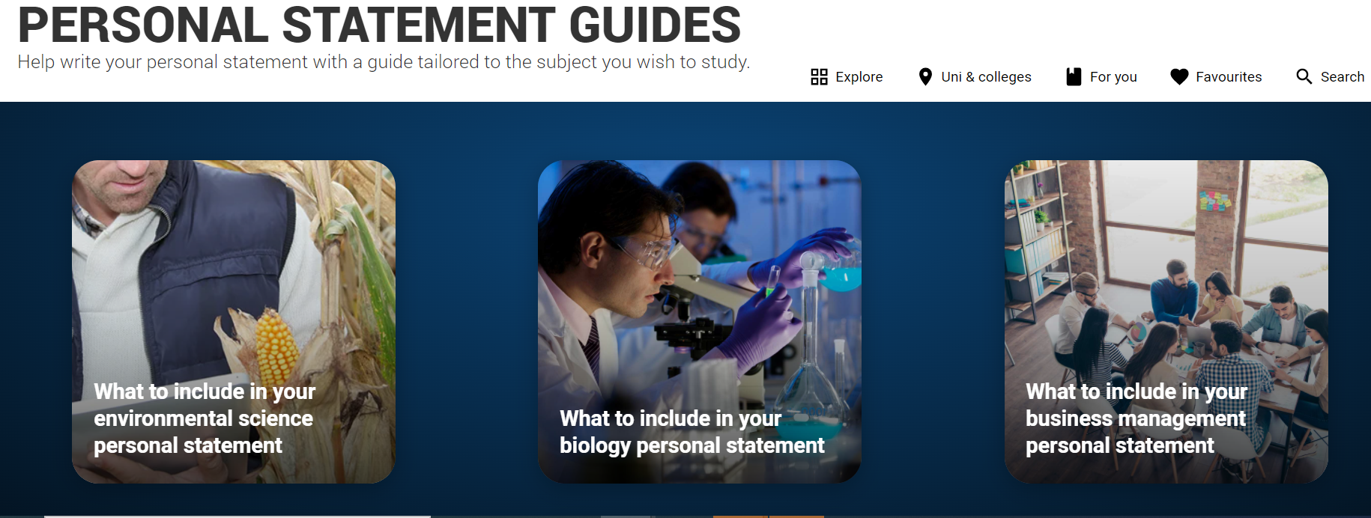
The UCAS personal statement
UCAS’ similarity detection service:
every personal statement is run through software to check for plagiarism.
The only section you have full control over
Your only chance to market yourself as an individual
One personal statement for all of your choices
A maximum of 4,000 characters, or 47 lines
Skills-based statement relevant to subject(s) applying for
There isn’t a spelling or grammar check
No copying of previous or example statements allowed

Slide 15
How do universities make decisions?
Universities review the:
They may also ask for:
personal statement
admissions test
qualifications
interview
reference
portfolio/audition
24 June 2024

Slide 16
Student Finance for University
Separate application to UCAS application
Tuition fees (studying in England - up to £9,250)
Maintenance loans (depends upon household income, where you study, where you live and how long for)
Other support (Disabled Students’ Allowance, scholarships, bursaries and grants)
Please refer to the following…
https://www.ucas.com/money
https://www.gov.uk/student-finance
https://www.moneysavingexpert.com/students/

Slide 17
Applications for University: Key Dates
Preparation in A1 for A2 checklist tasks (inc. a draft personal statement of at least 3000 characters)
UCAS applications can’t be sent off until 3 Sept 2024 at the earliest
College internal UCAS deadlines:
Early Applicants 27 September 2024
Other Applicants 15 Nov 2024
UCAS equal consideration deadline 29 January 2025
Apply for Student Finance via .gov.uk around March 2025

Slide 18
Thank you. Any questions?
Security marking: PUBLIC
24 June 2024
| 18

